Slide 1


Outreach Is Our Primary Purpose
presented by: OA Region 7 Outreach Committee

Slide 2
Our Mission
Outreach is our Primary Purpose!
OA’s Responsibility Pledge: “Always to extend the hand and heart of OA to all who share my compulsion; for this I am responsible.”
OA Preamble: “Our primary purpose is to abstain from compulsive eating and compulsive food behaviors, and to carry the message of recovery to those who still suffer.”

Slide 3
Agenda
Intergroup Outreach
Intergroups can participate in Outreach / PIPO* activities in their local community
These Outreach events have the potential to spread the word about OA to people who have never heard about us, or the OA fellowship
Resources: resources are available to all OA Intergroups - let’s talk about where to look.
* PIPO stands for Public Information / Professional Outreach

Slide 4

Where can we get $ help with Outreach?
OA Region 7
OA.org (OA World Service)
OA Bookstore

Slide 5
Region 7 - Requesting Subsidy for Costs relating to Outreach Events
Up to 50% support of fees
Up to the limit of current Outreach budget
https://oaregion7.org/forms/funding-application-for-public-outreach/
Process to request R7 Funding for Outreach
General notes:
R7 will fund up to 50% of the cost of an event registration fee or other expense
Funds are allocated in the Region 7 budget (determined annually during Fall Assembly) and are approved in the order in which requests are received
Funding requests that exceed the Outreach annual budgeted amount will only be approved up to the budgeted amount for that calendar year
An online application (link below) must be submitted by the Intergroup to request funds at least 2 months prior to the event
For events where R7 provided support, the Intergroup must complete the Summary Feedback Form (link below) no later than 30 days after the event.
R7 Policy Manual requirements:
Funding for outreach may be made by any authorized member of the intergroup.
Allow time for your funding request to be considered by the Region 7 Outreach committee, whose goal is to act quickly. We recommend two months’ notice but will work as quickly as possible to accommodate urgent needs.
Be clear about funding time constraints for your project.
Be as detailed as possible in your request; including specific expenses for your project as well as your intergroup’s monetary contribution to the project.
Keep receipts for expenditures related to this request, as you will be asked to provide copies of them to the Committee Chair within two weeks of the completion of the funded project.
Please complete the summary feedback form within 30 days of the event/project completion.
Region 7 Support

Slide 6
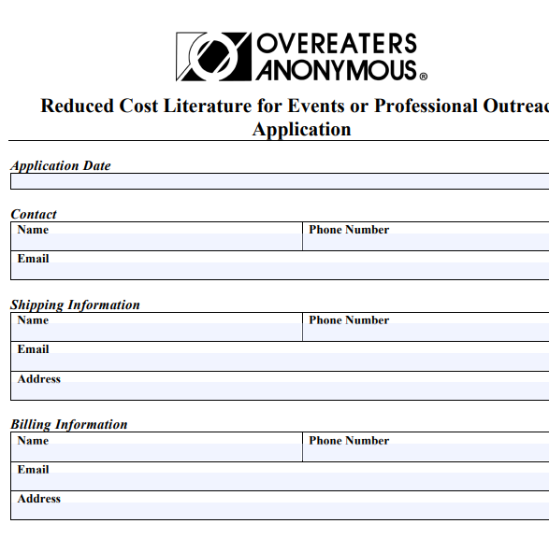
OA.org Provides Reduced Cost Literature for Outreach events
https://media.oa.org/app/uploads/2023/01/12134736/reduced-cost-literature-for-events-or-professional-outreach-application.pdf
The online application form includes instructions for completing and submitting the form. We can select from literature to tailor the pamphlets to a targeted audience.
The Region Chair & Region Trustee Liaison will likely be asked by oa.org to verify the event.
Note: links may change over time
OA World Service Support

Slide 7
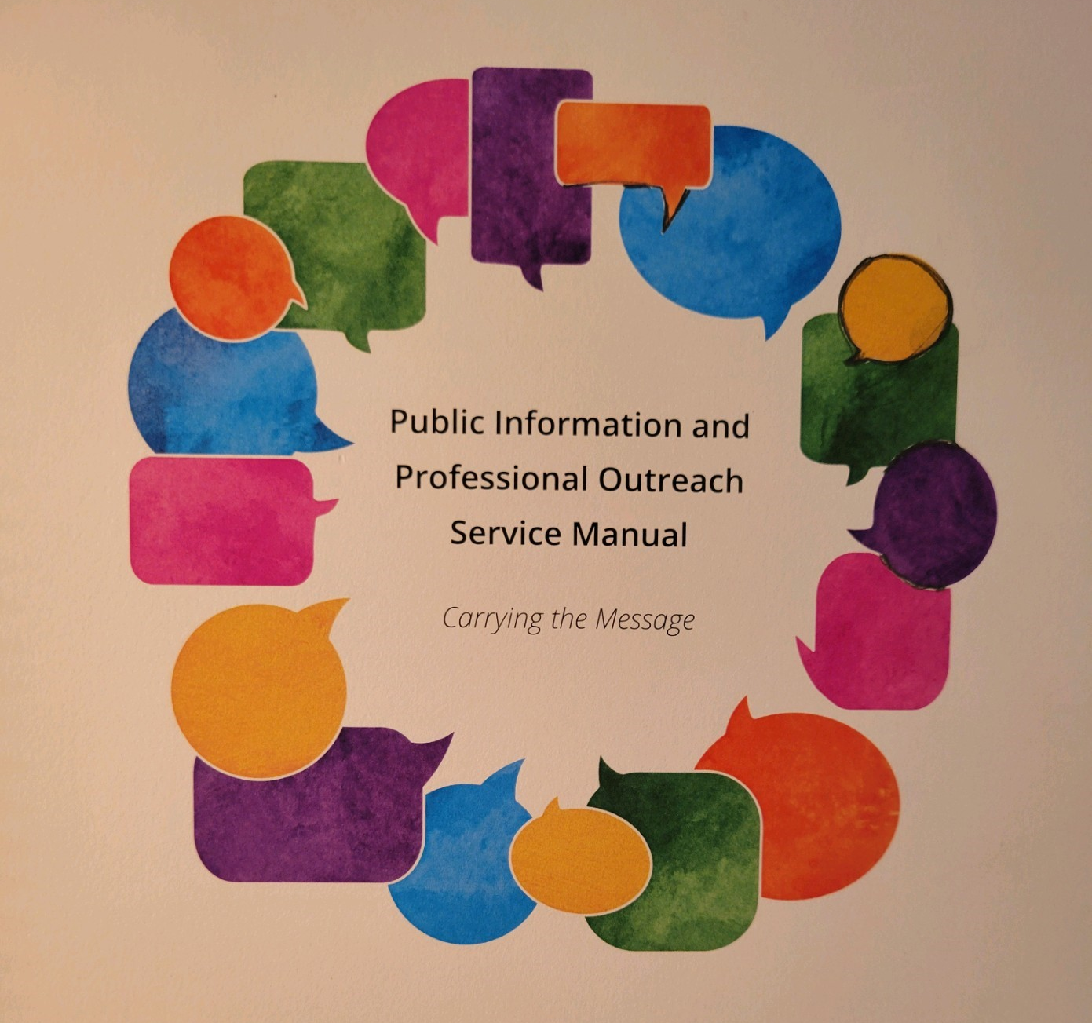
Public Information and Professional Outreach Service Manual
Is sold in the OA Bookstore on OA.org; gives detailed instructions on how to plan and run Outreach events.
OA.org - Bookstore

Slide 8
Screenshots
Find more information @
Screenshots of:
Region 7 website
OA.org

Slide 9
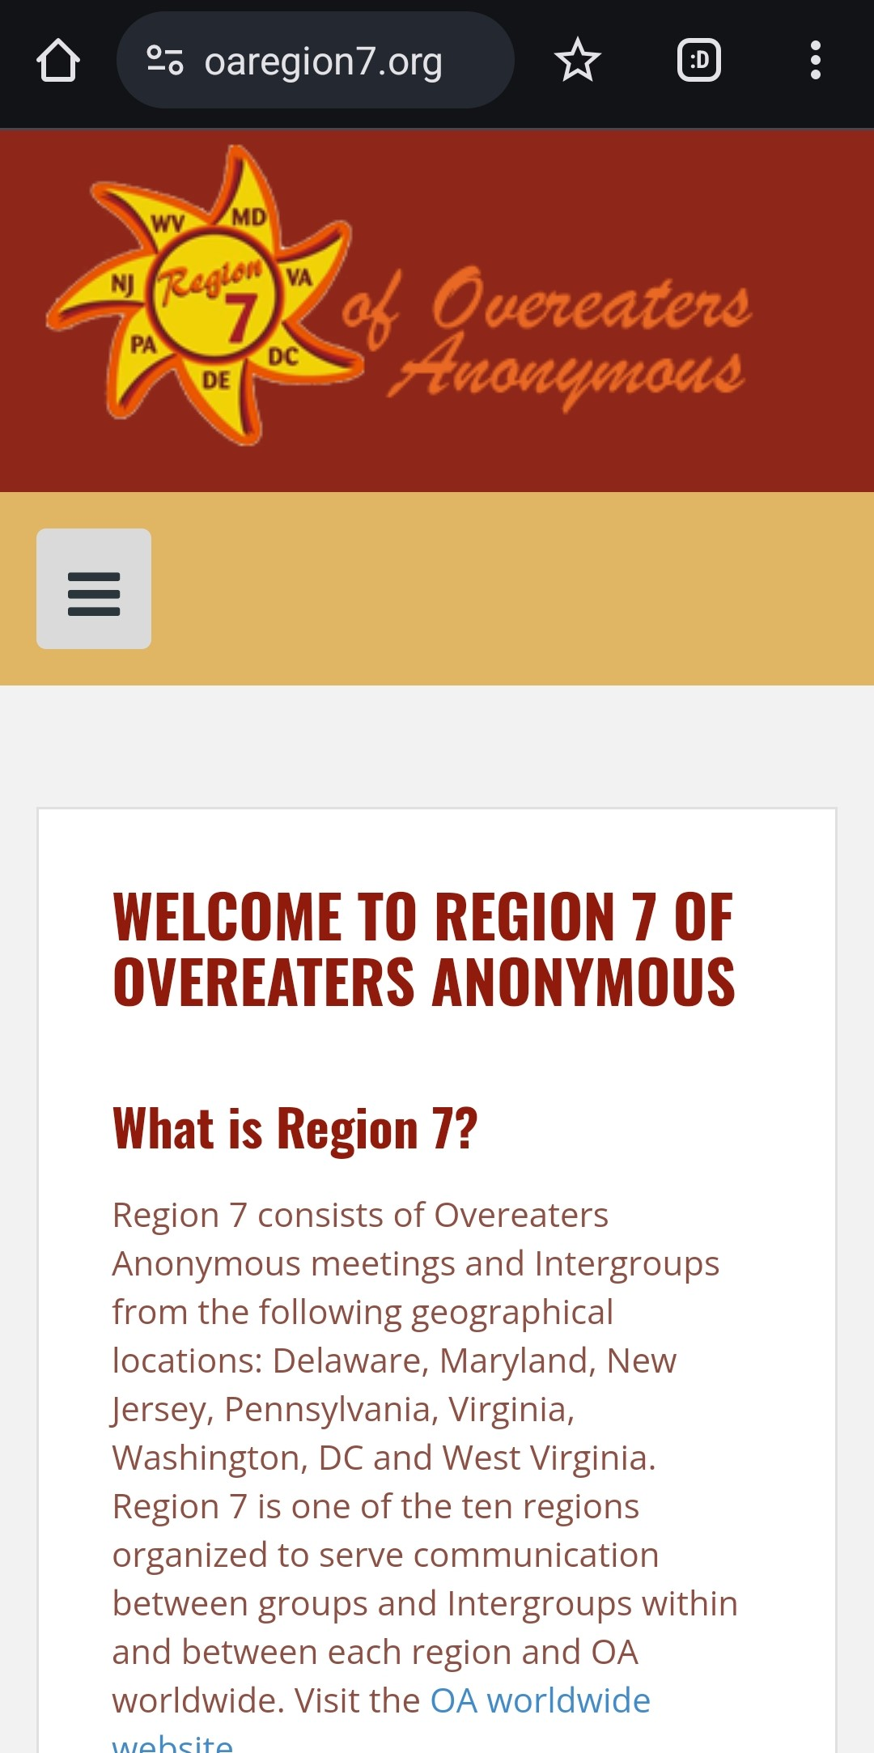
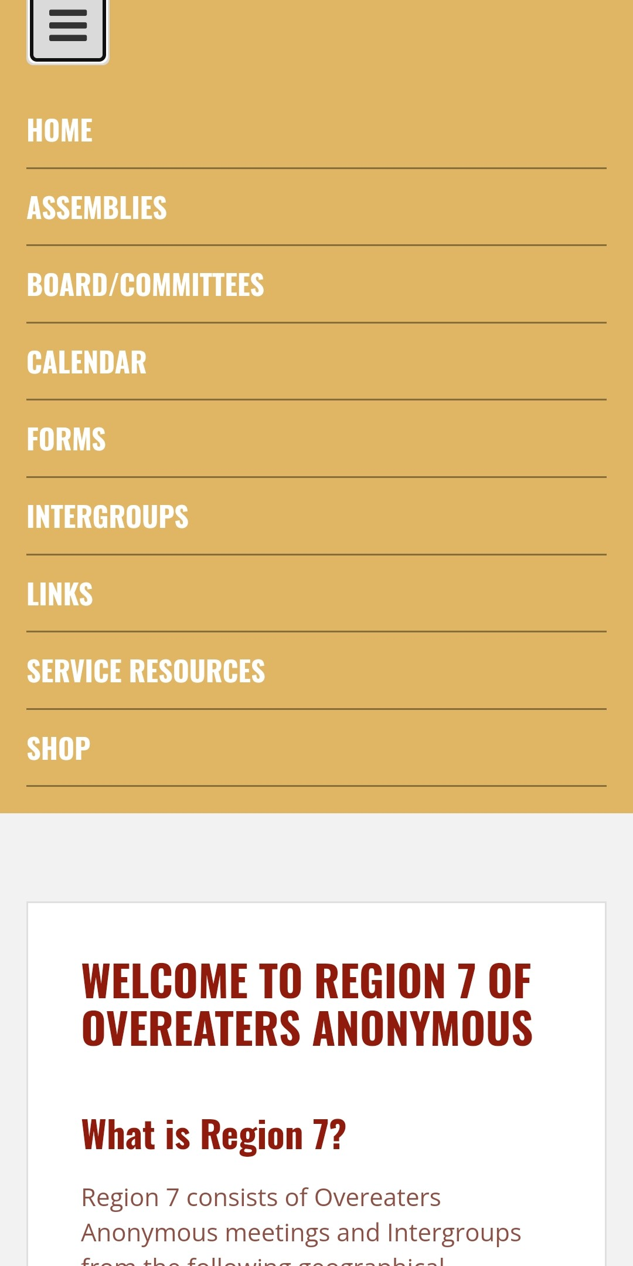
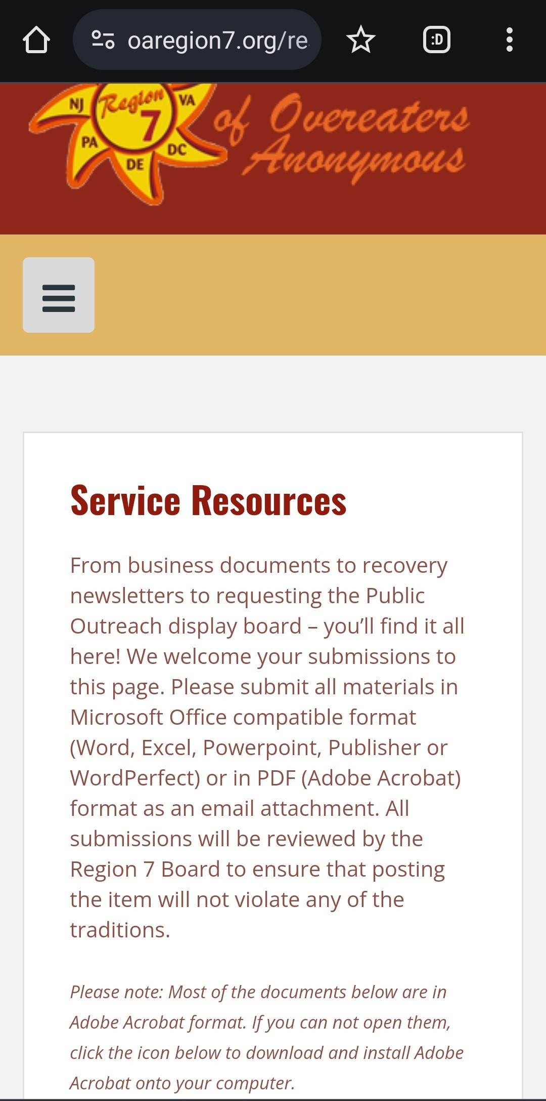
Outreach Resources on Region 7 Website
On Region 7 Home Page
Select,
“Service
Resources”
R7 Service Info

Slide 10
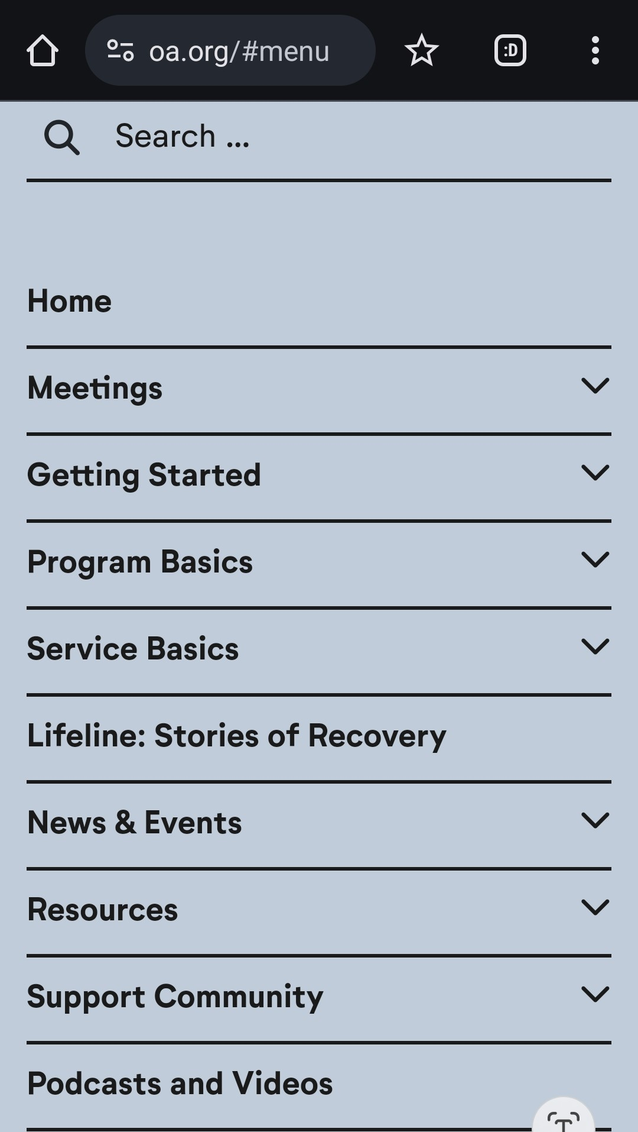
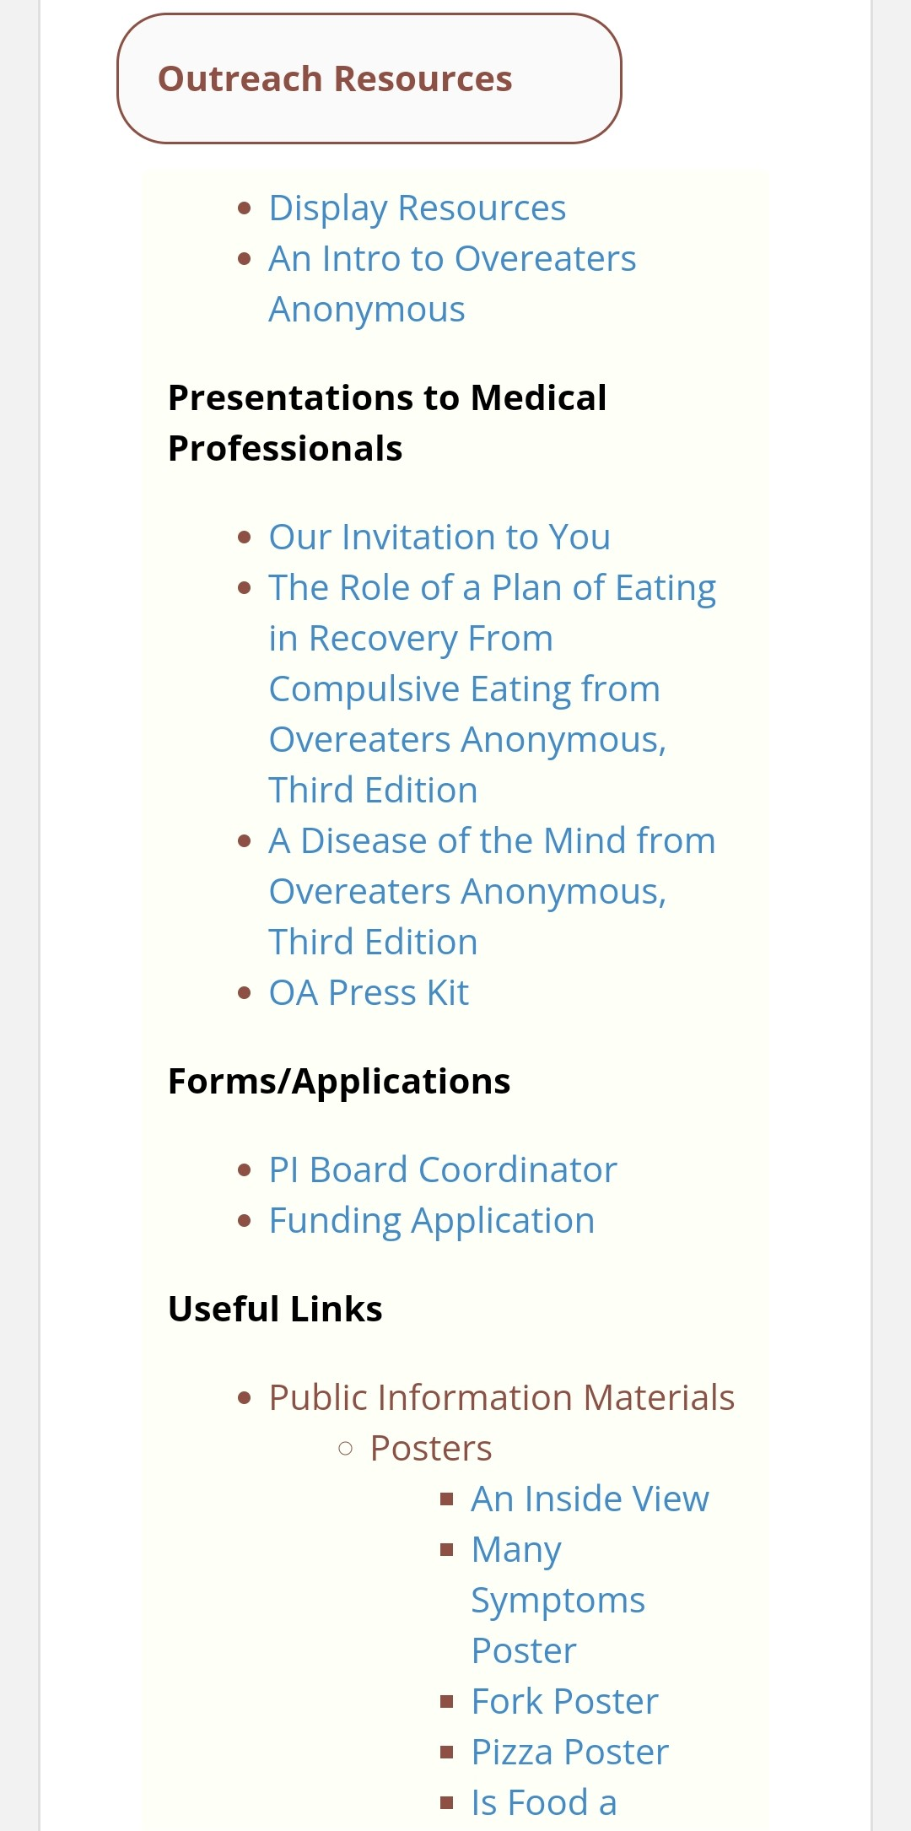
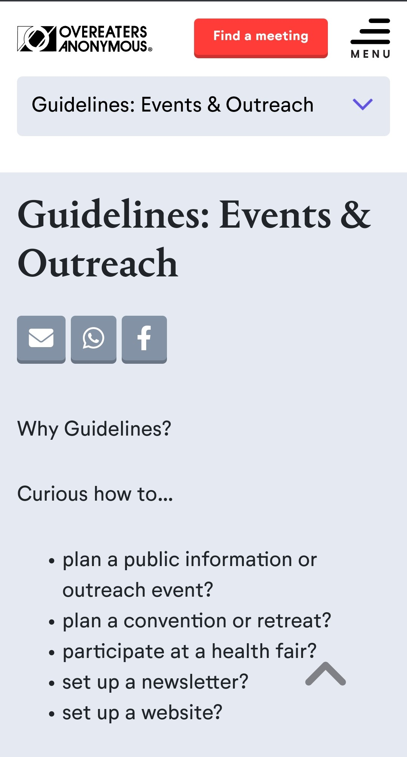
Resources from World Service: www.oa.org

Slide 11

Any questions?
R7 Outreach is here to help!

